Slide 1
EMAIL SPAM CLASSIFIER PROJECT

Slide 2
PROBLEM STATEMENT
The SMS Spam Collection is a set of SMS tagged messages that have been collected for SMS Spam research. It contains one set of SMS messages in English of 5,574 messages, tagged according being ham (legitimate) or spam.
A subset of 3,375 SMS randomly chosen ham messages of the NUS SMS Corpus (NSC), which is a dataset of about 10,000 legitimate messages collected for research at the Department of Computer Science at the National University of Singapore. The messages largely originate from Singaporeans and mostly from students attending the University. These messages were collected from volunteers who were made aware that their contributions were going to be made publicly available.

Slide 3
UNDERSTANDING:
The project aims to classification email into two categories and it is titled by Email Spam classification
Is implemented by using some methodology like Data preparation, Modelling and Evaluation steps. It is implemented using Python class object based style. The spam detection is done using machine learning algorithms classifier like Naïve Bayes, ANN(artificial neural networks), and SVM(support vector machines).
This project is all about to classify the email whether it is spam or not. So, in the project the SMS collection is a set of SMS tagged messages that have been collected for spam research. It contains messages in English of 5,574 messages, tagged according being ham which means legitimate or spam. The total corpus of 5728 documents. The target feature consists of two classes ham and spam, the column name is spam. The classes are labelled for each document in the dataset and represent our target feature with a binary string-type alphabet of ham and spam and these are further mapped to integer 0(ham) and 1(spam).

Slide 4
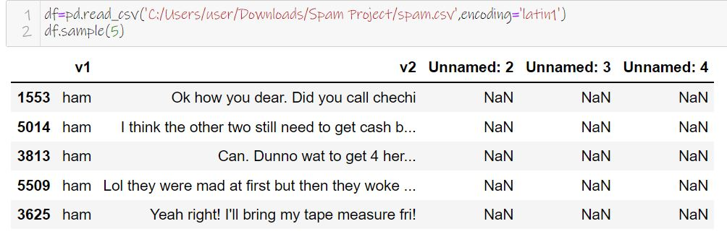
EDA STEPS AND VISUALIZATIONS:
Data Collection

Slide 5
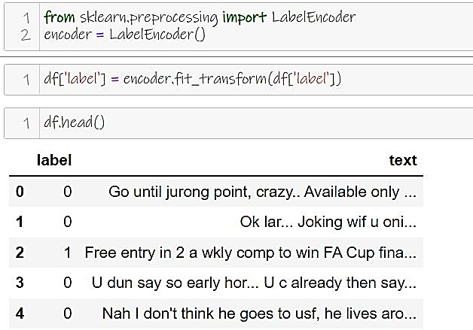
The target feature consists of two classes ham and spam, the column name is spam. The classes are labelled for each document in the dataset and represent our target feature with a binary string-type alphabet of ham and spam and these are further mapped to integer 0(ham) and 1(spam).

Slide 6
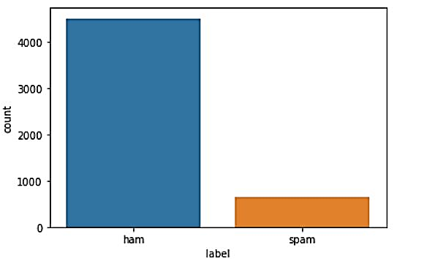
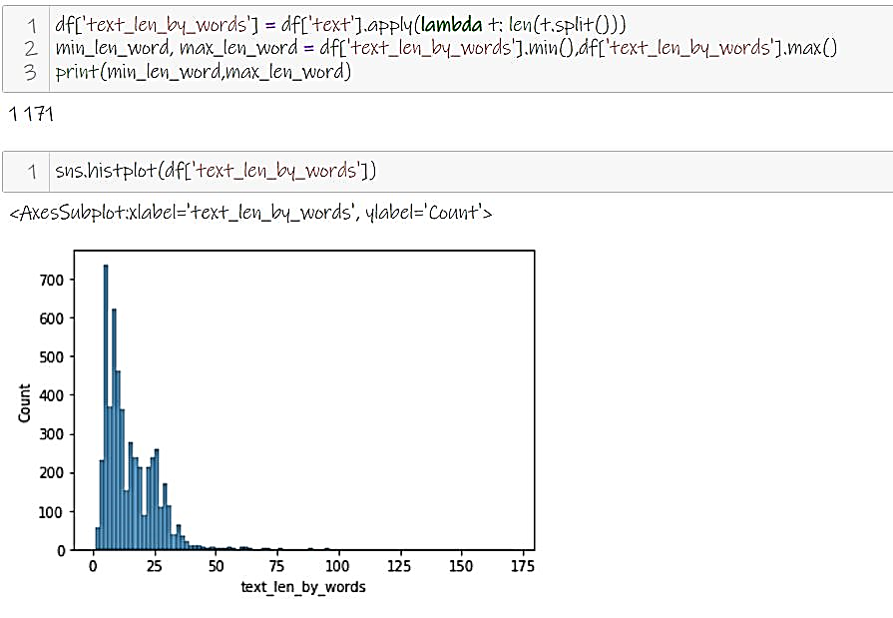
The blue bar depicts ham emails which is on the highest point in comparison to the orange bar which depicts spam emails in the dataset.
It is about the histogram of text length of words

Slide 7
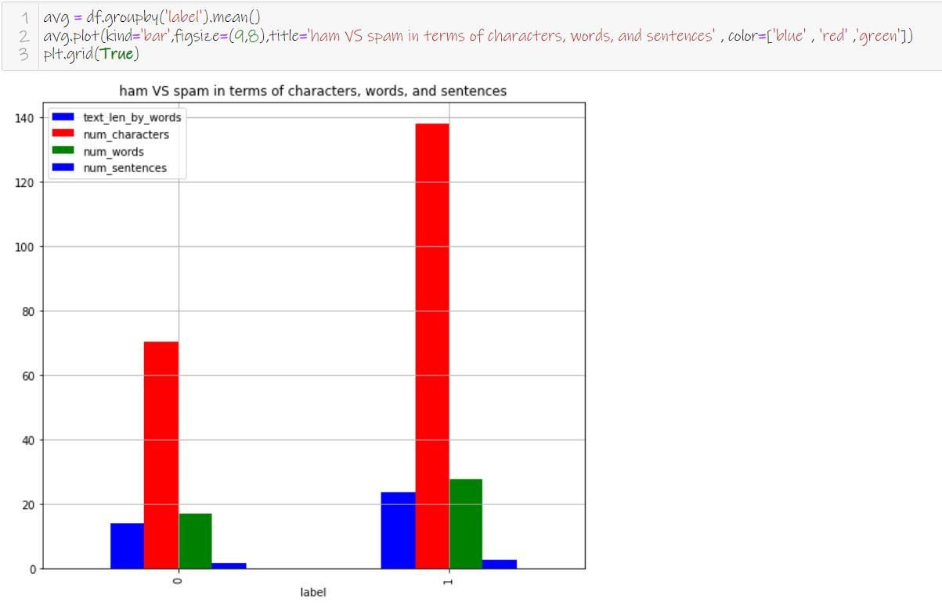
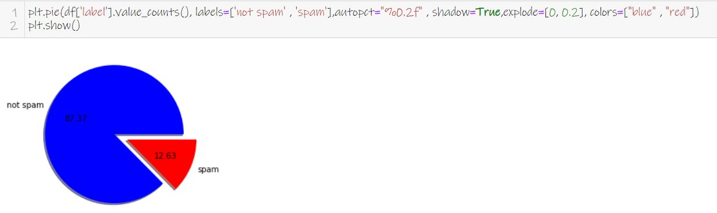

Slide 8
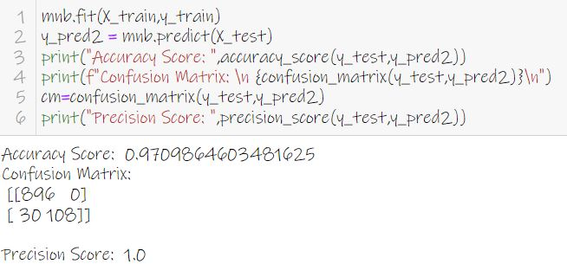
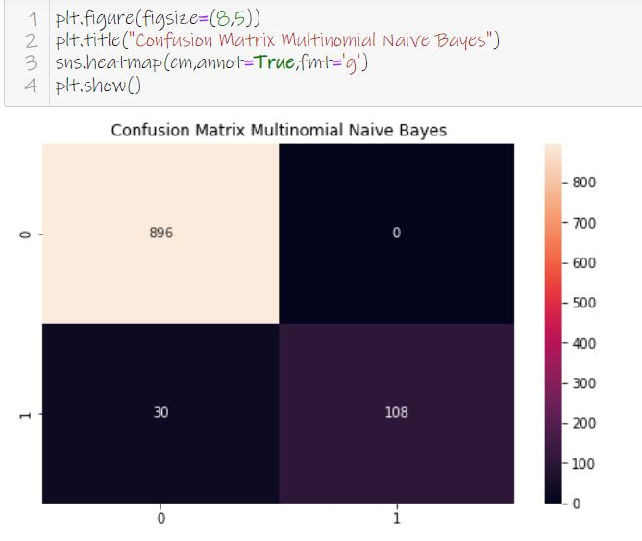

Slide 9
STEPS AND ASSUMPTIONS TO COMPLETE THE PROJECT:
The results were interpreted from the visualizations, preprocessing and modelling:
Comparing both Naïve Bayes and SVM, I found that Naïve Bayes has 1% improvement over the SVM model when the result compared to test data set.
2. Most of the transactions and business is taking through e-mails.
3.Nowadays, email becomes a powerful tool for communication as it saves a lot of time and cost. But, due to social networks and advertisers, most of the emails contain unwanted information called spam.
4. Even though lot of algorithms has been developed for email spam classification, still none of the algorithms produces 100% accuracy in classifying spam emails.
5. In this project spam dataset is analysed using data mining tool to explore the efficient classifier for email spam classification.
6. Initially, feature construction and feature selection is done to extract the relevant features.
7. Then various classification algorithms are applied over this dataset and cross validation is done for each of these classifiers.
8. Finally , best classifiers for email spam is identified based on the error rate, precision and accuracy.

Slide 10
CONCLUSION
We are able to classify the emails as spam or non-spam. With high number of emails lots if people using the system it will be difficult to handle all possible mails as our project deals with only limited amount of corpus.

Slide 11
THANK YOU

